Slide 1
Muhammad Musa
CIT Training
04-11-2021

Slide 2
Business Incubation
Business Incubation is the name given to the process, wherein an individual or an organization supports the establishment and growth of a start-up.
Those supporting the start-up or new companies are called business incubators.
Business incubators help the start-ups to manage finances and ensure proper utilization of the money.
There are three stages of business incubation which are; 1. Physical Facility Support 2. Networking Facilities 3. Support Services

Slide 3
Business Acceleration
A business accelerator is a program that gives developing companies access to mentorship, investors and other support that help them become stable, self-sufficient businesses.
Companies that use business accelerators are typically start-ups that have moved beyond the earliest stages of getting established.
There are two main kinds of business accelerators: 1.Seed Programs
2.Second-stage Programs

Slide 4
Business Value Statement
Business value statement means what’s important to your company, what it prioritizes, and how it conducts itself.
The value statement should show what the company believes in.
It’s the backbone which can be referred back to as context for what to do next, how to act, and so on.
A value statement isn’t essential to the running of a company, but it’s important for companies to have a clear idea of who they are.
A value statement is a declaration that announces a company’s top priorities and core beliefs, both to guide their employees’ actions and also to connect with consumers.

Slide 5
Business Model Canvas
The Business Model Canvas (BMC) is a strategic management tool to quickly and easily define and communicate a business idea or concept.
It is a one page document which works through the fundamental elements of a business or product, structuring an idea in a coherent way.
The right side of the BMC focuses on the customer (external), while, the left side of the canvas focuses on the business (internal).
It allows everyone to get a clear idea of what the business will likely be.

Slide 6
Continued…
It allows us to get an understanding of your business and to go through the process of making connections between what your idea is and how to make it into a business.
It looks at what kinds of customer decisions influence the use of your systems.

Slide 7
Sales Strategy
A sales strategy is how you will convert them to customers.
A sales strategy describes how you will sell to that target audience and turn prospects into buyers.
The purpose of a sales strategy is to create the most effective path for turning interested prospects into paying customers.
A sales strategy may also address tactics for turning one-time customers into repeat buyers or referral sources.

Slide 8
Continued…
The sales strategy usually contains the following:
Forecasting
Prospecting
Lead tracking
Channel support
Customer meetings
Discounting strategies
Opportunity tracking

Slide 9
Marketing Stratregy
A marketing strategy is how you will reach your target audience.
A marketing strategy sets the direction for how you will find and engage with prospective customers so you can promote your core message and build interest in the brand.
The purpose of a marketing strategy is to capture and define marketing goals.
This includes marketing plans for how you will promote your product or service to reach the right customers, as well as for how you will achieve (and maintain) a competitive advantage in the market.

Slide 10
Continued…
The marketing strategy usually contains the following:
Company vision and goals
Value proposition
SWOT analysis
Marketing goals
Initiatives
Brand essence
Positioning
Buyer personas
Competitive landscape
Marketing channel strategy (e.g. branding, marketing automation, search, and social media)

Slide 11
How to Reach Customers and Engage CIO’s
Today, there are more ways than ever to connect with customers.
There's email, social media, mobile, meetings, focus groups, trade shows.
CIO asked dozens of business owners, managers and customer relationship experts to find out.
Following are their top 14 recommendations for how to connect with customers--and what makes those methods effective.

Slide 12
Continued…
1. Survey your customers: "Surveys allow businesses to identify user needs directly.“
2. Use newsletters: "It should have a table of contents up front so people will at least take three seconds to scan it, and the five to six articles should be short (two to three sentences) and include links to useful resources.“
3. Blog: "If you actively keep up a quality blog, not only will your customers read your blog, but they will respond to your blog“.
4. Pick up the phone: "There's nothing more direct than picking up the phone to call a customer or client.”
5. Go visit: It is critical to listen--and not walk in the door trying to sell them something.
6. Respond to email: "At our company, we make it our goal to respond to customer emails within five minutes, and the response we receive from our customers.”

Slide 13
Continued…
7. Send a personalized note or a postcard: "I love sending personalized cards by snail mail to let customers know I'm thinking of them.“
8. Be active on Twitter and Facebook: "One of the best ways to connect with customers is through social media, such as Facebook and Twitter.“
9. Use Instagram: "Instagram helps us stay connected and engaged with our customers and fans.“
10. Offer webinars: "Webinars--seminars delivered over the Internet--are a great way to keep the spice in your customer relationship.“
11. Empower salespeople: "Salespeople can make or break the retail experience."

Slide 14
Continued…
12. Provide exceptional customer service. "One of the most powerful tools an organization has to connect with its customers is its employee base.“
13. Go mobile. "Almost everyone is carrying some kind of mobile device today--92 percent of Americans have a mobile phone.“
14. Monitor review sites. "Whether it's Yelp, TripAdvisor or Angie's List, find out what customers are saying about your business [on review sites]."

Slide 15
Stakeholders Power Grid
The power/interest grid is a matrix used for categorising stakeholders during a change project to allow them to be effectively managed.
Stakeholders are plotted on the grid in relation to the power and interest they have in respect of the project.
You can identify stakeholders by looking at existing documentation, holding workshops, creating ‘as is’ business process maps and generally talking to people within the business.
The grid categorises stakeholders into the following four groups:
High power/high interest
High power/low interest
Low power/high interest
Low power/low interest

Slide 16
Continued…
Stakeholders with high power and high interest will want to be engaged with regularly, whereas stakeholders with low power and low interest do not require regular and detailed communication.
Once you have placed the stakeholder within the grid, you can look at which category they fall under and manage the stakeholder accordingly.

Slide 17
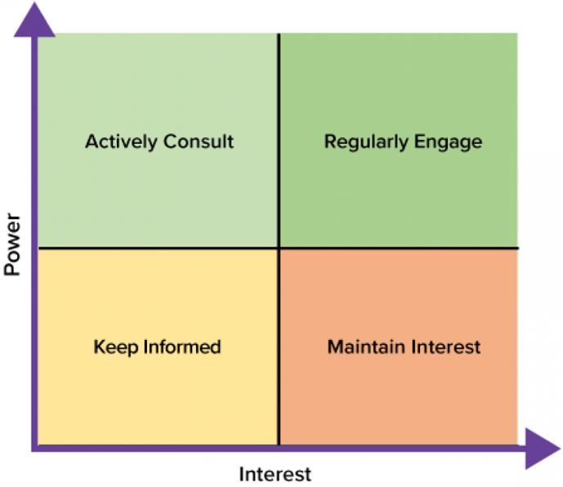
Continued…

Slide 18
RACI Model
The RACI model clearly lays out roles and responsibilities for any activity or group of activities.
Here are the basic elements of a RACI model;
Job functions or titles are noted across the top, such as “IT,” “Human Resources,” “Project Manager,” etc.
Tasks or responsibilities are noted down the left hand side, such as “Conduct weekly communication meeting with sales team,” or “Analyze prior-month performance and send out summary the first week of each month.”

Slide 19
Continued…
The cells inside the RACI model or chart are filled in based on the following criteria;
R = Responsible = The person who performs the work.
A = Accountable = The person ultimately accountable for the work or decision being made.
C = Consulted = Anyone who must be consulted with prior to a decision being made and/or the task being completed.
I = Informed = Anyone who must be informed when a decision is made or work is completed.

Slide 20
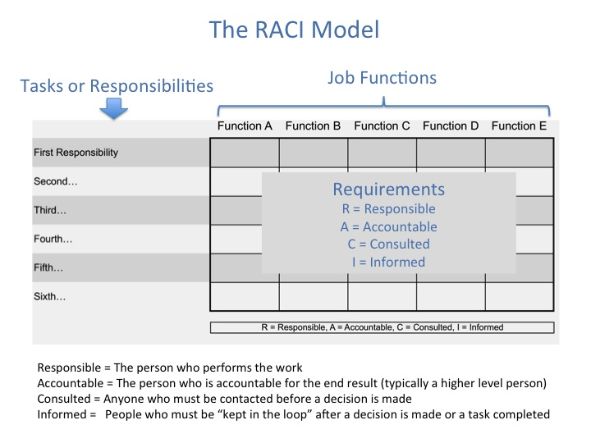
Continued…

Slide 21
SWOT Analysis
SWOT (strengths, weaknesses, opportunities, and threats) analysis is a framework used to evaluate a company's competitive position and to develop strategic planning.
SWOT analysis assesses internal and external factors, as well as current and future potential.
A SWOT analysis is designed to facilitate a realistic, fact-based, data-driven look at the strengths and weaknesses of an organization, initiatives, or within its industry.
SWOT Analysis was first used to analyze businesses.

Slide 22
Continued…
Strengths: Strengths describe what an organization excels at and what separates it from the competition: a strong brand, loyal customer base, a strong balance sheet, unique technology, and so on.
Weaknesses: Weaknesses stop an organization from performing at its optimum level.
Opportunities: Opportunities refer to favorable external factors that could give an organization a competitive advantage.
Threats: Threats refer to factors that have the potential to harm an organization.

Slide 23
PEST Analysis
PEST Analysis (political, economic, social and technological) is a management method whereby an organization can assess major external factors that influence its operation in order to become more competitive in the market.
As described by the acronym, those four areas are central to this model.
This type of analysis is used to gauge external factors that could impact the profitability of a company.
PEST analysis is commonly used in conjunction with SWOT analysis, which stands for strengths, weaknesses, opportunities, and threats.

Slide 24
Continued…
The political aspect of PEST Analysis focuses on the areas in which government policy and/or changes in legislation affect the economy, the specific industry, and the organization in question.
PEST Analysis can assist an organization in recognizing and thereby capitalizing on opportunities offered by existing conditions in the business environment.
It can also be used for identifying current or possible future challenges, allowing for effective planning of how to best manage these challenges.

Slide 25
SMART Objectives
SMART Objectives are defined as a set of objectives and goals that are put in place by parameters, that bring structure and tractability together.
SMART is an acronym that stands for:
S – Specific
M – Measurable
A – Achievable
R – Relevant
T- Time-based

Slide 26
Continued…
SMART method also happens to be a very practical resource that certainly can be a lifesaver for relevant people working in competitive fields like marketing, sales, advertising, market research and similar.
SMART objectives in the fields mentioned are for all those people who want to meet a specific goal.
So, to give your team members a proper objective to work with, start making an excellent approach by using the SMART method.

Slide 27
Continued…
S-SPECIFIC: Dwelling deeper into details is a good start.
M-MEASURABLE: For a goal to be an objective clearly, you must have a quantitative way of measuring that you have effectively achieved it.
A-ACHIEVABLE: It is advisable to know that there is going to be difficult tasks to achieve and that you have no choice but to achieve them.
R-RELEVANT: To define relevant and realistic goals, you must measure the scope of your potential and of those who are associated with you in your organization or business.
T-TIME-BASED: Schedule and put a time to the objective.

Slide 28
OKRs
“OKR” stands for “Objectives and Key Results.”
OKRs are an effective goal-setting and leadership tool for communicating what you want to accomplish and what milestones you’ll need to meet in order to accomplish it.
OKRs are used by some of the world’s leading organizations to set and enact their strategies.
It is a collaborative goal-setting methodology used by teams and individuals to set challenging, ambitious goals with measurable results.
OKRs are how you track progress, create alignment, and encourage engagement around measurable goals.

Slide 29
OPEX
Operating expenses (OPEX) are costs not directly associated with the production of the goods or services but commonly incurred during regular business activities.
In other words, these are day-to-day expenses that cannot be classified as costs of producing the company’s goods or services or costs of purchasing assets.
OPEX are costs incurred while developing regular business activities.
OPEX means costs associated with the core functions of a business.

Slide 30
CAPEX
A capital expenditure (CAPEX) is an expense that a company makes towards the purchase of new equipment or the improvement of its long-term assets, namely property, plant, and equipment.
CAPEX usually pertains to maintenance expenditures that seek to extend the useful life of the company’s assets through repair or upgrade or to expansion expenditures that the company makes when seeking expansion of its product line, entry in a new market or acquisition of a new business.
CAPEX means the purchase of a fixed asset that has a useful life of more than one year.

Slide 31
ROCE
Return on capital employed (ROCE) is a financial ratio that can be used to assess a company's profitability and capital efficiency.
The ROCE ratio is one of several profitability ratios financial managers, stakeholders, and potential investors may use when analyzing a company for investment.
Return on capital employed is similar to return on invested capital (ROIC).
ROCE can be especially useful when comparing the performance of companies in capital-intensive sectors, such as utilities and telecoms.
For a company, the ROCE trend over the years can also be an important indicator of performance.

Slide 32
Final Assessment
A final assessment is the last activity students must complete in a course.
A final assessment may be an exam, a culminating activity or a combination of the two.
A final assessment is similar in nature to a summative assessment, which includes end-of-unit tests, standardized testing and cumulative work such as curating a portfolio over the duration of a course.
A final assessment refers to the task that evaluates students’ progress in a course.
This is a way for students to recognize their weaknesses and for instructors to understand where they have excelled and where improvement is needed when teaching.

Slide 33
Continued…
A final assessment ultimately provides instructors with data about their teaching and their students’ learnings.
This type of assessment is a tool by which students get to know what they have learned, and instructors may know about how they are teaching.
Through this assessment, the instructor can examine the understanding of six different parameters – analysis, knowledge, synthesis, comprehension, evaluation, and application are the parameters.

